Slide 1

Module 4
Advanced Multiple Linear Regression (MLR)
Notes:
Guidelines
Use section headers to chunk content in your presentation.
Use the same style of section header throughout your presentation.
Keep your title to no more than 2 lines.

Slide 2
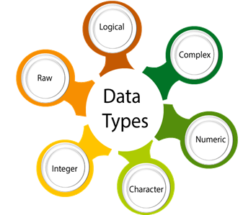
More on Variable Types
Notes:
Guidelines
Use a title slide at the beginning of your presentation. There are 9 variations of title slides to choose from.
If you will have a series of slideshows, we recommend using the same style of title slide for each presentation.
Keep your title to no more than 2 lines.
Do not change the font style or font size of the title or subtitle.

Slide 3
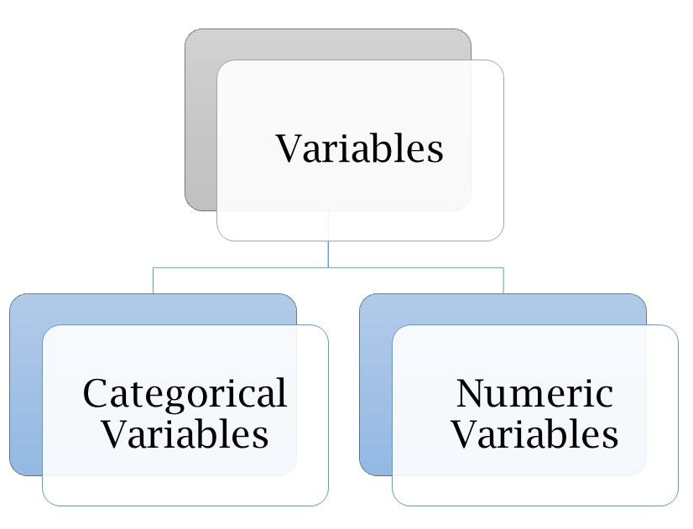

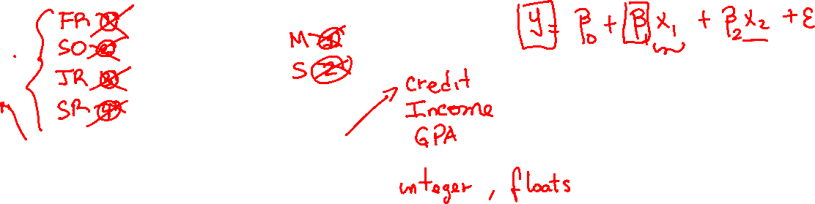
Variable Types
Quantitative (Numeric) Predictors: assume numerical values corresponding to points on a line.
Qualitative (Categorical or Factor) Predictors: have categories

Slide 4
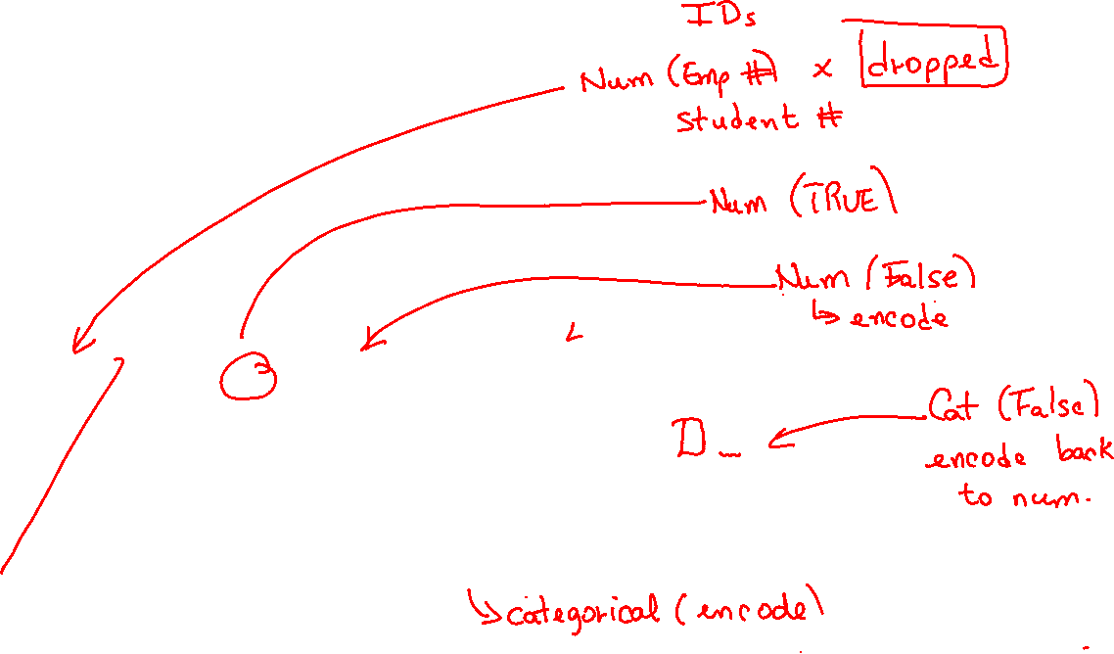
Variable Types
We may need to correct types on real data

Slide 5
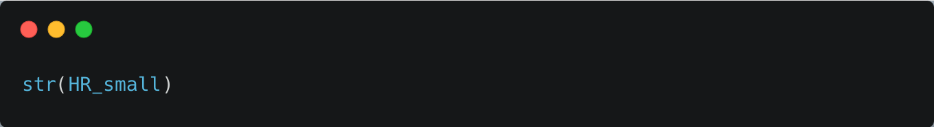
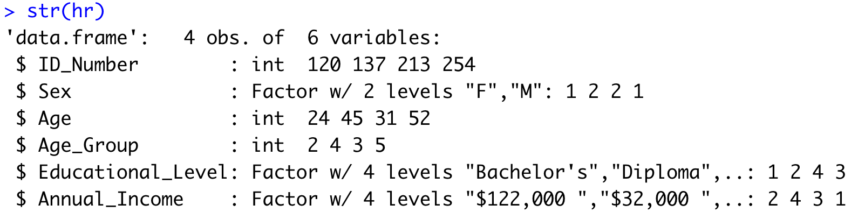
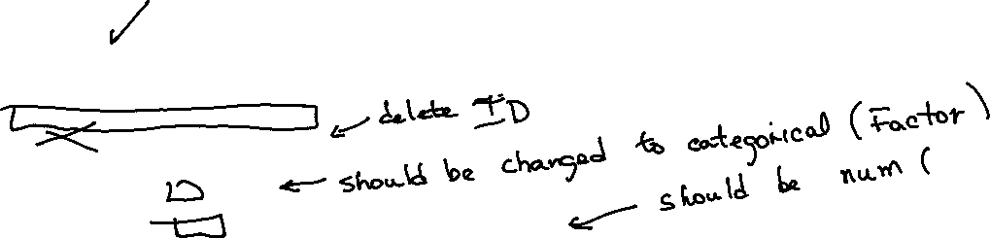
Variable Types

Slide 6

Correcting Variable Types
Changing categorical variables to numeric

Slide 7
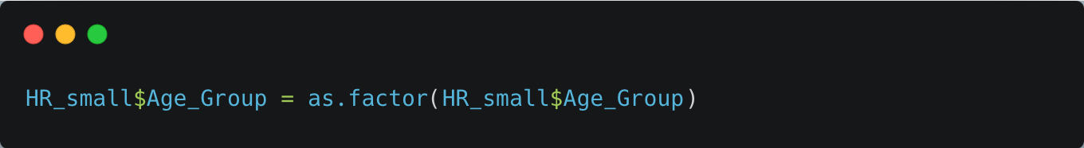
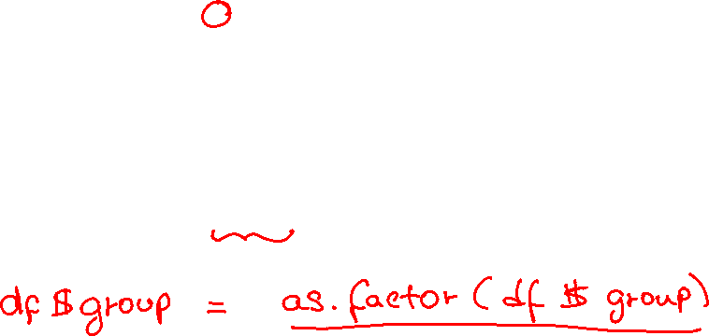
Correcting Variable Types

Slide 8
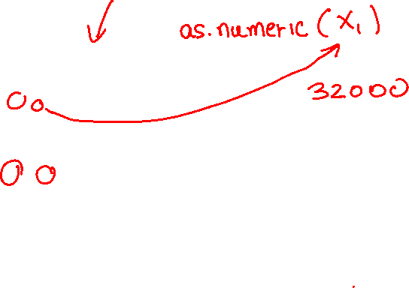
Correcting Variable Types
Changing numeric variables to categorical

Slide 9
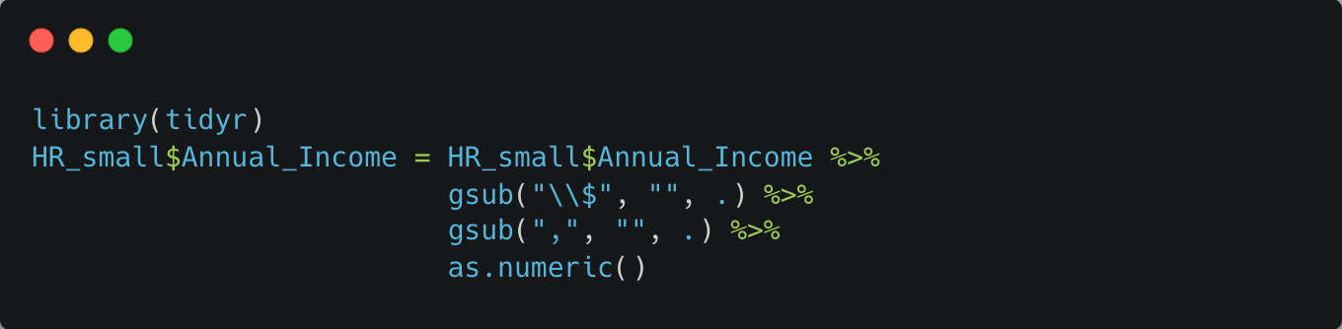
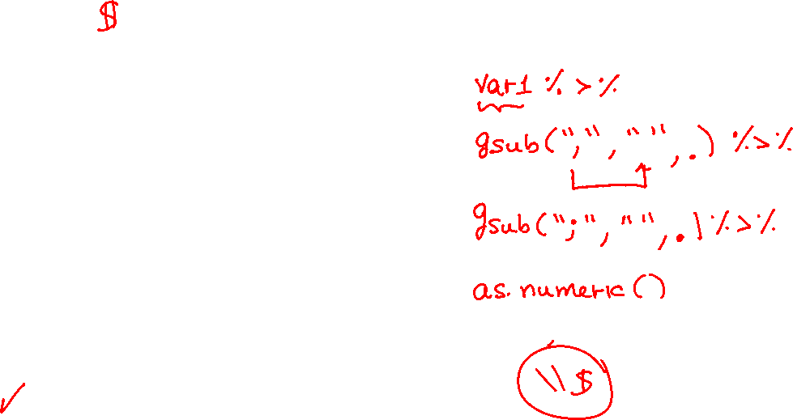

Correcting Variable Types

Slide 10
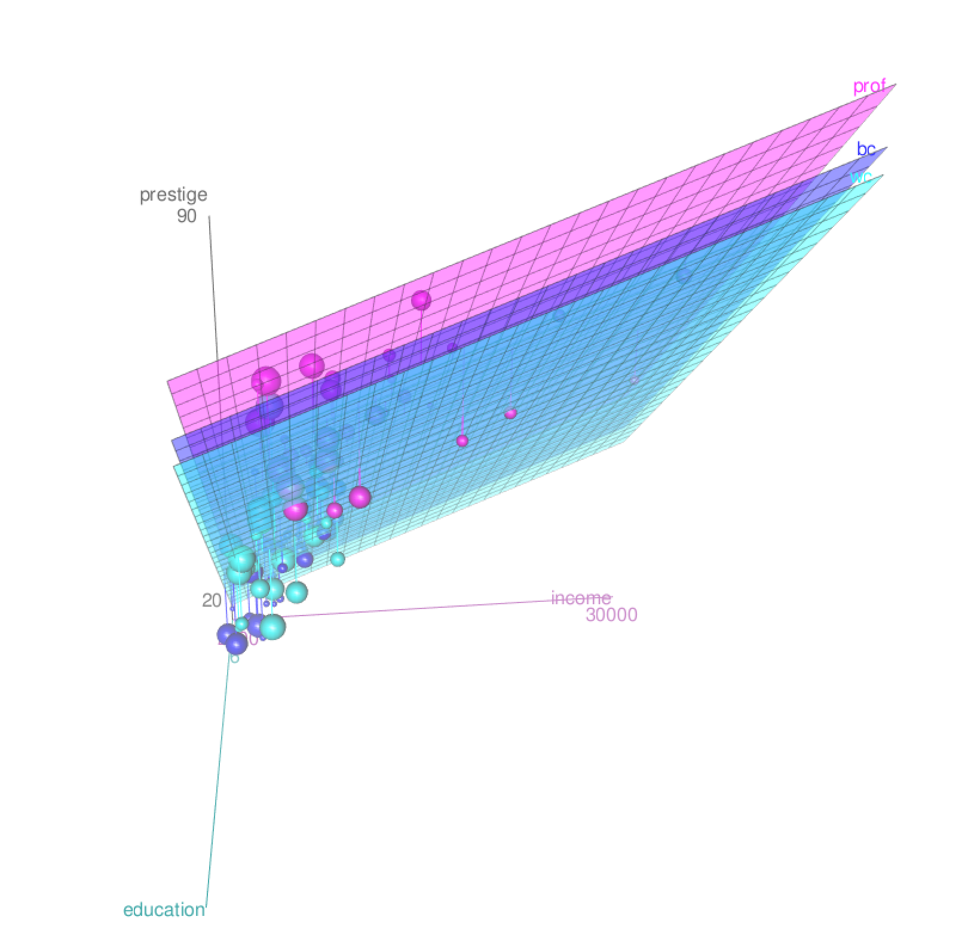
MLR with Categorical Predictors
Notes:
Guidelines
Use a title slide at the beginning of your presentation. There are 9 variations of title slides to choose from.
If you will have a series of slideshows, we recommend using the same style of title slide for each presentation.
Keep your title to no more than 2 lines.
Do not change the font style or font size of the title or subtitle.

Slide 11
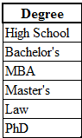

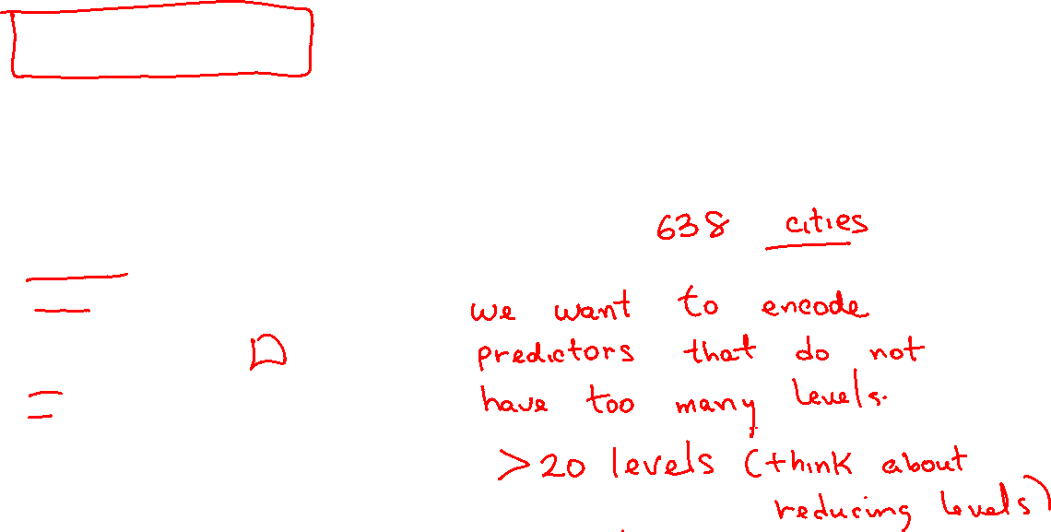
# of Levels in Categorical Variables
The Levels of a qualitative factor are defined only by the categories
6 levels

Slide 12
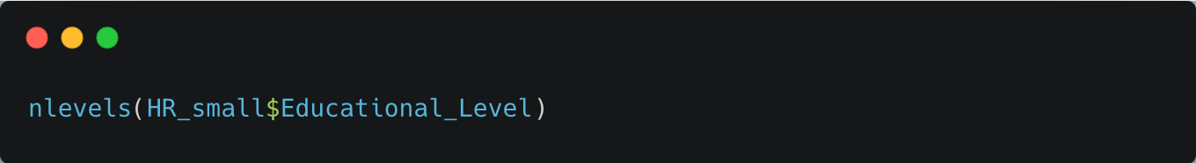
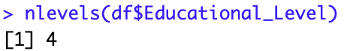

# of Levels in Categorical Variables

Slide 13
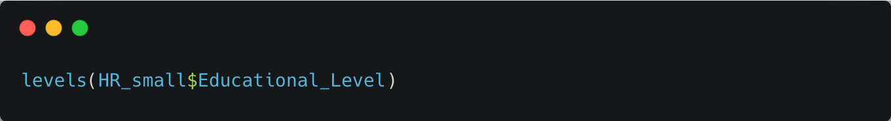
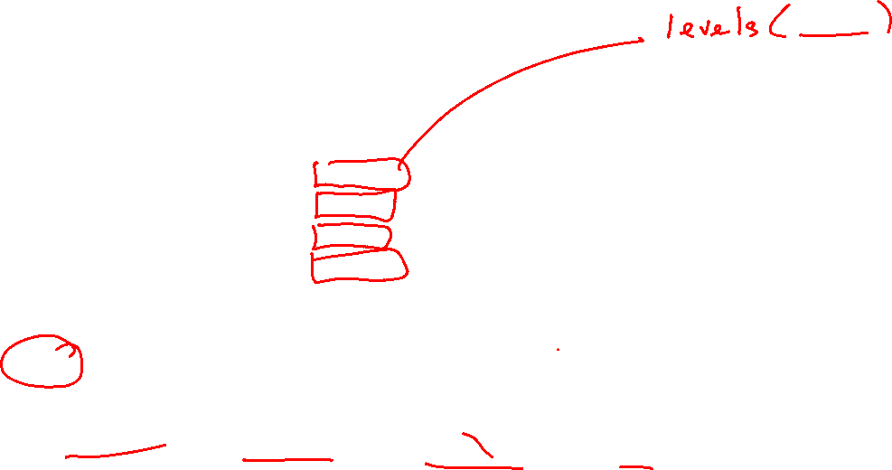

Levels in Categorical Variables

Slide 14
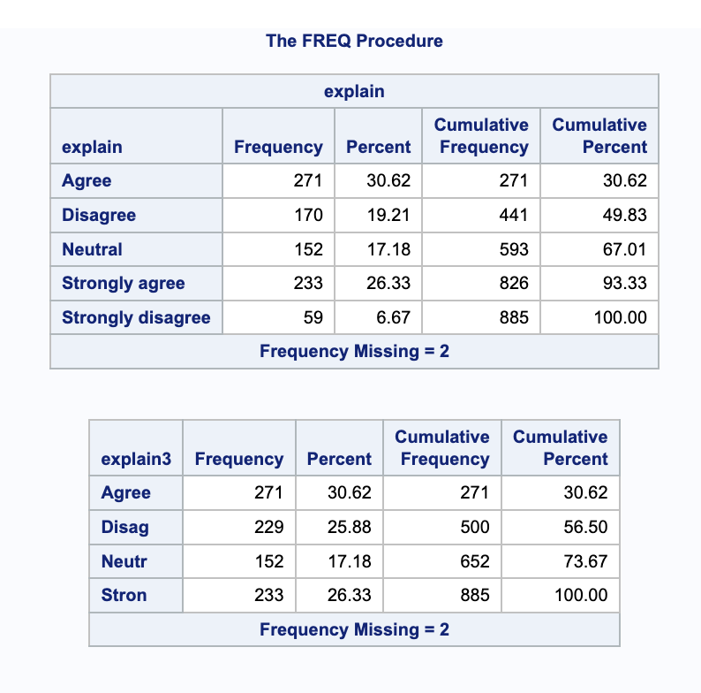

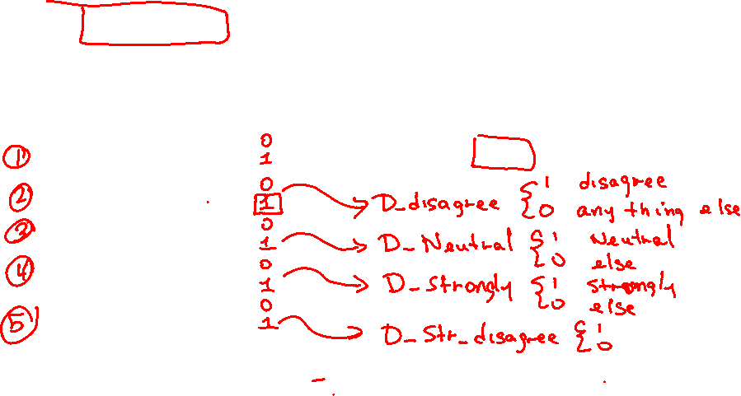
Reference Level Categorical Variables
Used in dummy-encoding.
Reference or base level is the level we compare against.
By default, most programming languages use alphabetical order
Default reference (base) level

Slide 15


Changing a Reference Level
We can change the reference level if needed
New reference (base) level

Slide 16
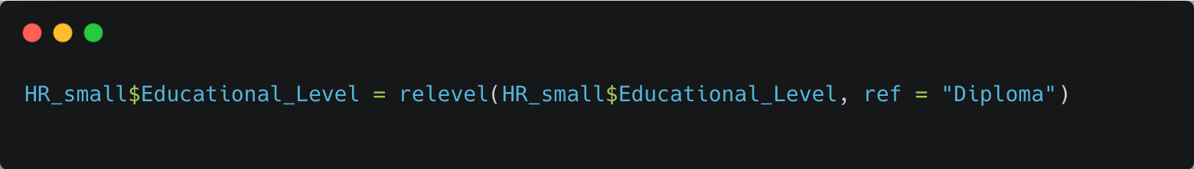

Changing a Reference Level
We can change the reference level if needed

Slide 17
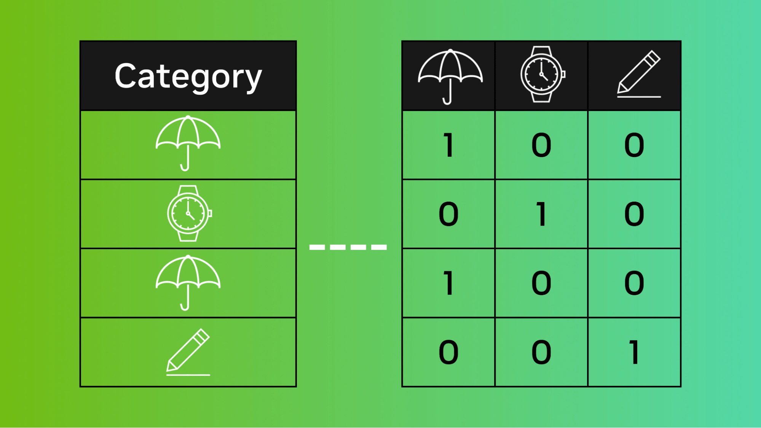

Encoding Categorical Variables
Notes:
Guidelines
Use a title slide at the beginning of your presentation. There are 9 variations of title slides to choose from.
If you will have a series of slideshows, we recommend using the same style of title slide for each presentation.
Keep your title to no more than 2 lines.
Do not change the font style or font size of the title or subtitle.

Slide 18
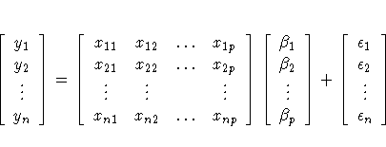


Categorical Variable Encoding
Every categorical variable has to be encoded numerically
Model matrix needs to be completely numeric

Slide 19
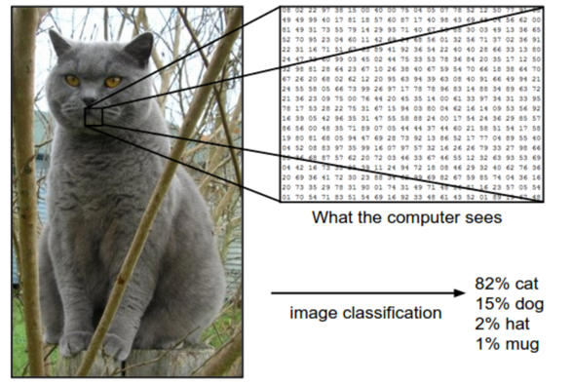
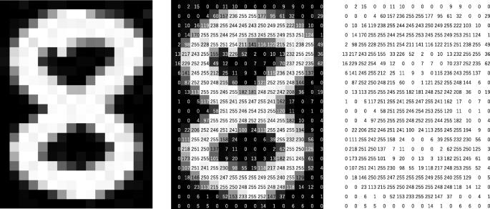

We can encode most types of data

Slide 20
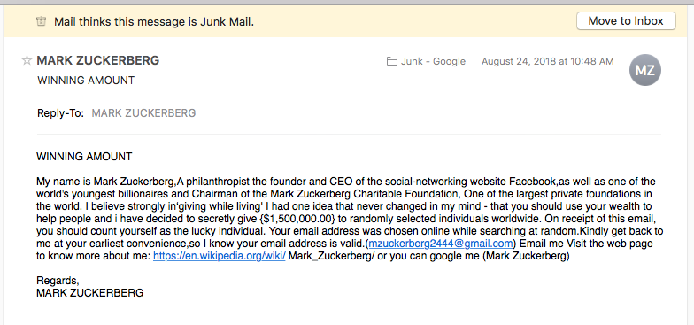

We can encode most types of data

Slide 21
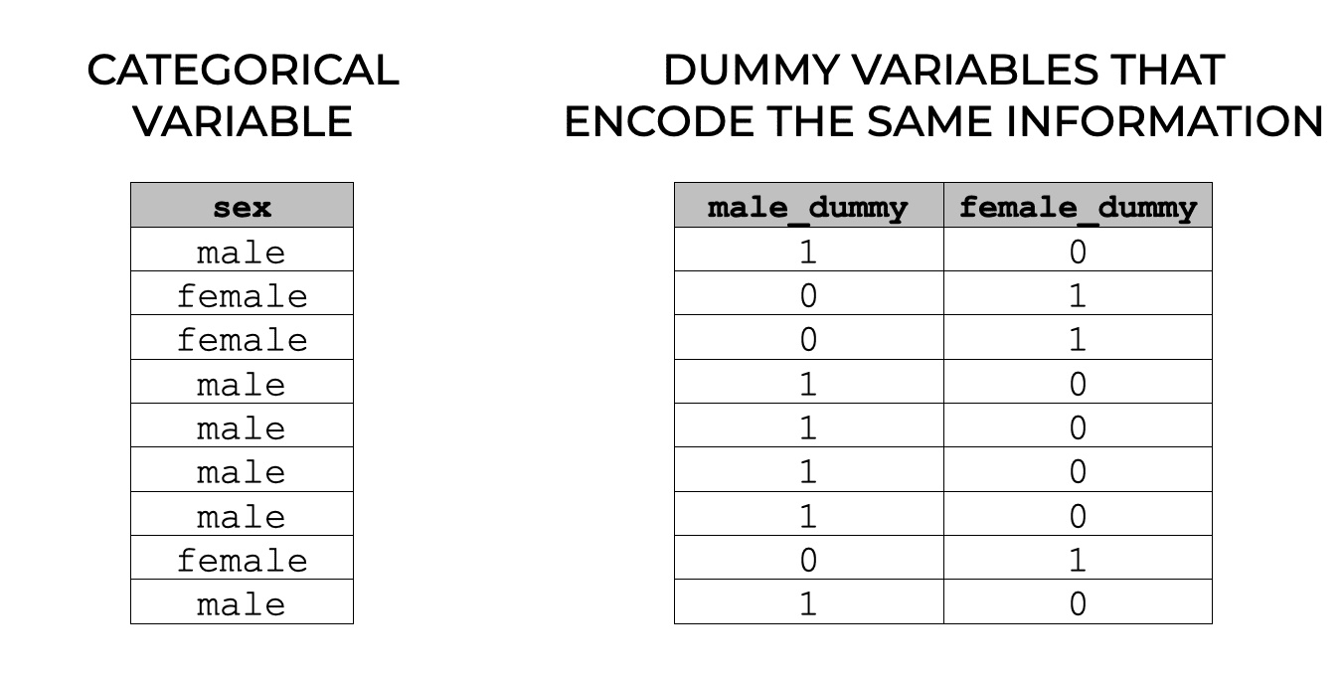
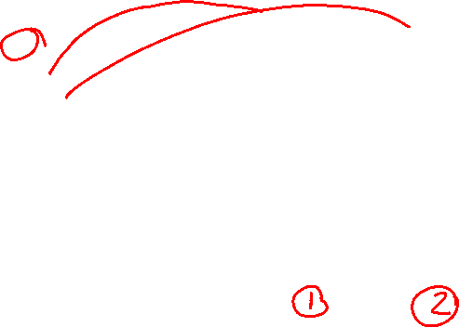
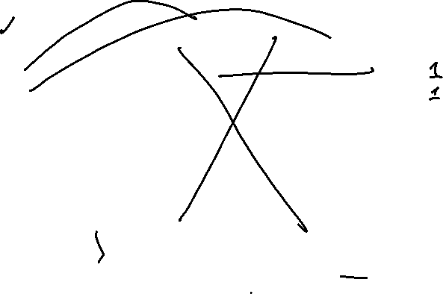
One-Hot Encoding
One-hot encoding creates 1 dummy variable per level

Slide 22
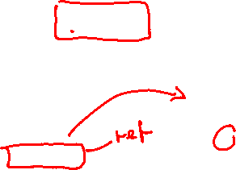
Dummy-Encoding
Dummy encoding creates (# levels – 1) dummy variables
The reference level is left out

Slide 23

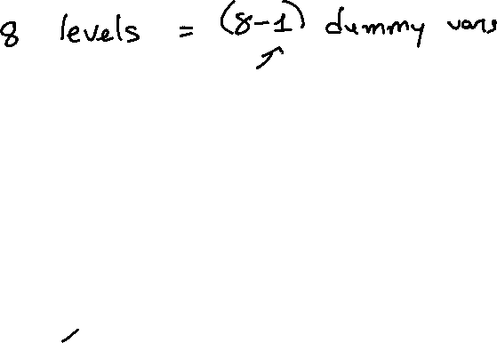
Dummy-Encoding
Dummy encoding creates (# levels – 1) dummy variables
The reference level is left out

Slide 24
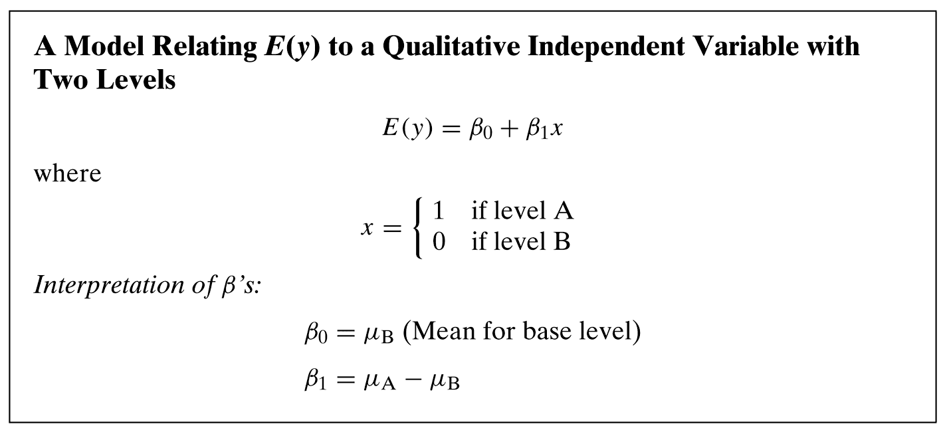
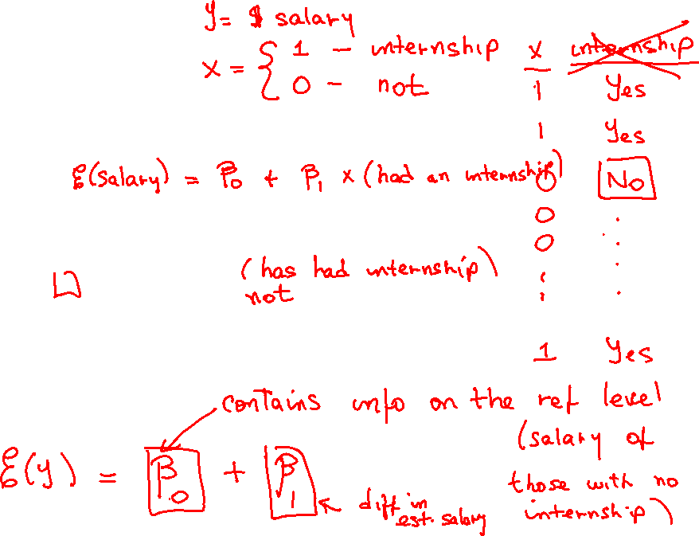
Dummy-Encoding

Slide 25



Please download and install the Slido app on all computers you use
An airline company wants to predict the fare price (in dollars) for flights departing from different airports. The company runs a linear regression with FARE as the dependent variable and five airports as the independent variable. The airports are: • Airport A • Airport B • Airport C • Airport D • Airport E “Airport A” is used as the baseline category, and dummy variables are created for the other airports: D_B , D_C , D_D , and D_E. What is the expected fare for a flight departing from Airport D with a distance of 500 miles?
ⓘ Start presenting to display the poll results on this slide.

Slide 26
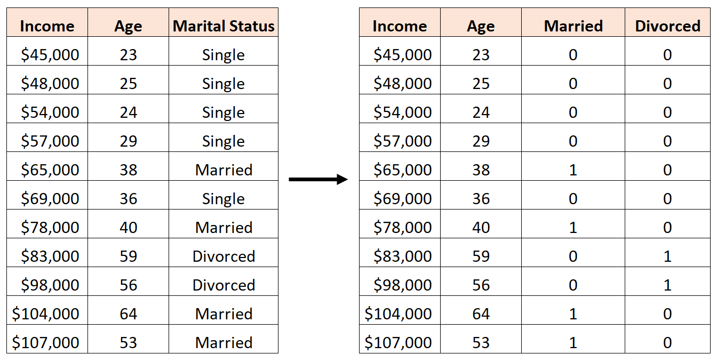
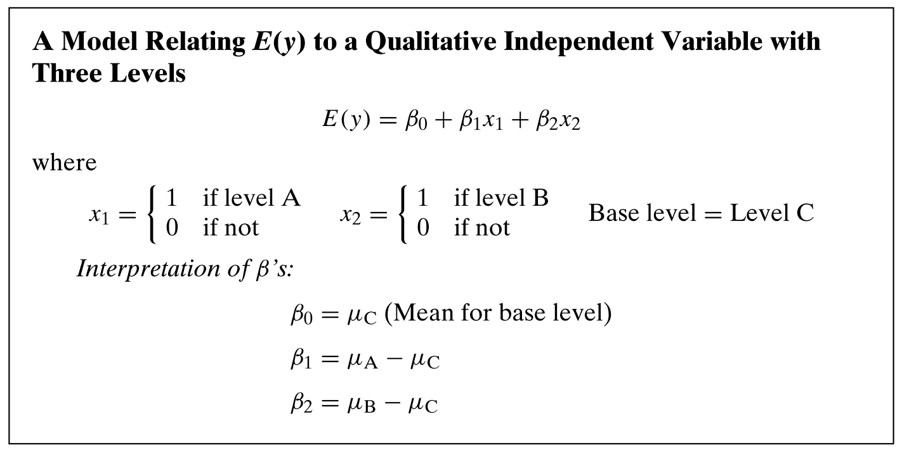
Dummy-Encoding

Slide 27
Dummy-Encoding

Slide 28
Please download and install the Slido app on all computers you use
You run a linear regression with Income as the dependent variable, and Age, Marital Status (dummy variables: Married and Divorced, with Single as the baseline), as the independent variables. Based on this regression output, what is the expected income of a 40-year-old divorced individual?
ⓘ Start presenting to display the poll results on this slide.

Slide 29
Please download and install the Slido app on all computers you use
In a linear regression model where Income is the dependent variable, and Age and Marital Status (with dummy variables: Married and Divorced, using Single as the baseline) are the independent variables. What is the correct interpretation of the y-intercept (30,000) in this regression equation?
ⓘ Start presenting to display the poll results on this slide.

Slide 30
Please download and install the Slido app on all computers you use
A company wants to predict employee satisfaction (measured on a scale of 1 to 100) based on their role in the company and their years of experience. The roles are categorized into four groups: Junior Staff, Mid-level Staff, Senior Staff, and Management. A linear regression is run using “Junior Staff” as the baseline, with dummy variables created for the other roles. Based on this regression model, what is the expected satisfaction score for a Mid-level Staff member with 5 years of experience?
ⓘ Start presenting to display the poll results on this slide.

Slide 31
Please download and install the Slido app on all computers you use
A company wants to predict employee satisfaction (measured on a scale of 1 to 100) based on their role in the company and their years of experience. The roles are categorized into four groups: Junior Staff, Mid-level Staff, Senior Staff, and Management. A linear regression is run using “Junior Staff” as the baseline, with dummy variables created for the other roles. Which role earns the least?
ⓘ Start presenting to display the poll results on this slide.

Slide 32

Practice

